Slide 1


Slide 2

Product Overview
Mission
Product
To promote online education in Nigeria
Cloud-based School Management System
PRODUCT OVERVIEW
Competitive Advantage
Vision
SMS software reference for A-level Schools in Nigeria.
Targeted Customers- A-Level Schools

Slide 3


Slide 4
PROBLEM
MARKET GAP
Most School Management Systems are targeted towards primary and secondary schools. Nobody seems to think A-level schools should adopt online Education
CUSTOMERS
50,000+ students enroll into A-level schools annually. There are at least 5 privately owned A-Level schools in every state in Nigeria. These students are registered and managed using manual processes.
usability
Customers want something that’s easy to adopt and simple to use
Costs
A-level schools sometimes experience low enrolment due to inability of students to travel to their location. Also, they provide accommodation for students incurring large expenses

Slide 5




Solution
Close the gap
Target Audience
Our product provides school management systems tailored to the needs of locally owned A-Level schools in Nigeria.
A-Level School Owners and Administrators
Cost savings
Easy to use
Schools are able to reduce accommodation expenses by using our product to reach and teach student regardless of their location.
Web-based, user friendly product that allows for intuitive navigation.​

Slide 6


Product SWOT Analysis
S
STRENGTHS
Saves cost and time, reducing workload of teachers and school administrators.
.
W
WEAKNESSES
Inadequate financial and human resources to implement ideas.
O
T
OPPORTUNITIES
There are at least 5 A-Level Schools in every Nigerian state
THREATS
Inadequate computer facilities by the school.
Low computer literacy of school staff.
Existing competitor products

Slide 7
Product Roadmap
Current and Proposed Features
Features:
Student Module
Learning Management
Teacher’s Module
Admin Module
Features:
Communication tools(Messaging, notice board)
Live Classes
Attendance Management
Features:
Live Examination proctoring
Billing and payments
Multiple Administrator
Admissions
Performance Tracking
Features:
Payroll Management
Generate Transcript (Academic Records)
Features:
Library Module
Parent Module
Creative Course Creation
Start
Stage 1
Stage2
Stage3
Stage4

Slide 8
Business Model Canvas
Activities
Values
Marketing
Whitelabeling
Onboarding
Support
Relationships
Partners
Customers
Remote Teaching
Targeted customer (A-Level Schools)
Online Education
Effective School Management
Post installation support
Social Media engagement
License providers
Investors
A-Level Schools
Regulators
A Level School Administrators
A-Level School Owners
Resources
Channels
Human Capital
Finances
Cloud services and hosting platform
Online Ads
Email Marketing
Walk-Ins
Influencer Marketing
Software Development
Marketing
Personnel cost
Costs
Revenues
Monthly/Annual Subscriptions

Slide 9
Product Design
Landing Page Prototype
HomePage Prototype

Slide 10


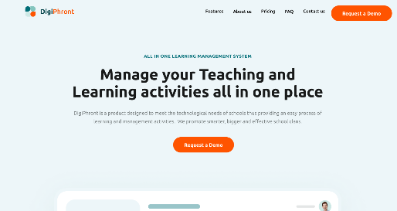


Product Demo

Slide 11
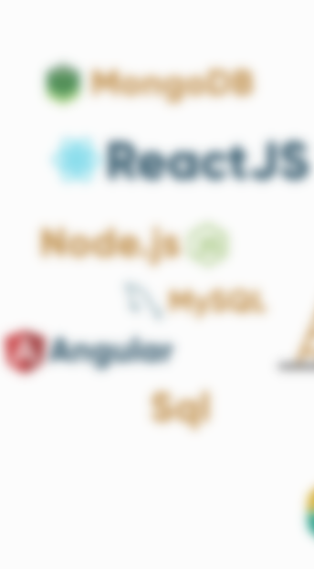
Tech stack
React JS
Nodejs/Express
MongoDB or MERN
Github
Figma

Slide 12
Our Team
Product Manager
Front-End Developer
Damilola Davids
Gbemisola Kotoye
Back-End Developer
Front-End Developer
Evelyn Anyebe
Remilekun Odegbami

Slide 13
Thank You!

